Slide 1

React Native

Slide 2
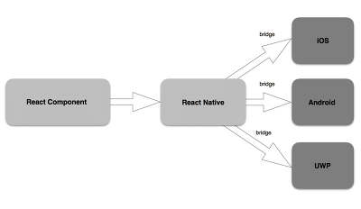
React Native?

Slide 3





장점

Slide 4
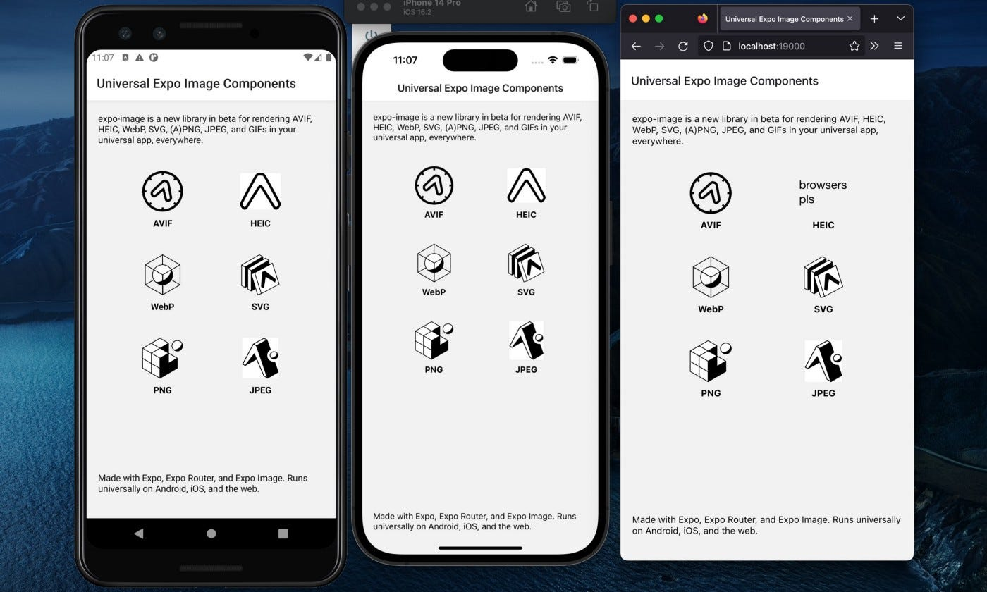
Expo?

Slide 5
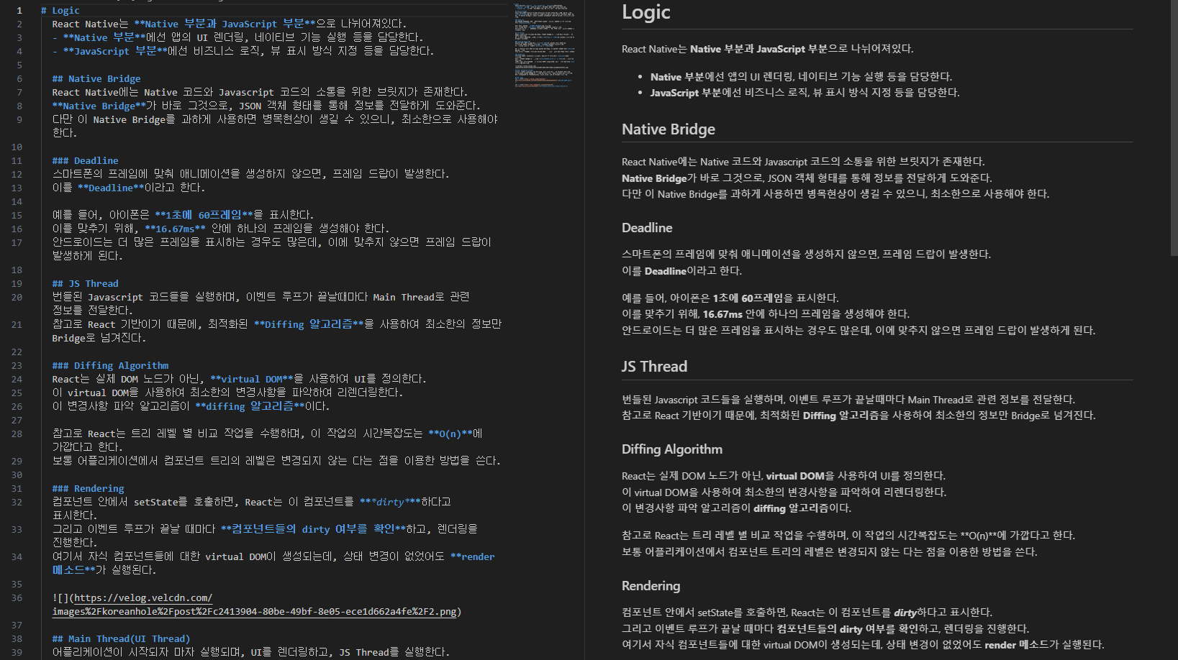
RN Logic

